Slide 1
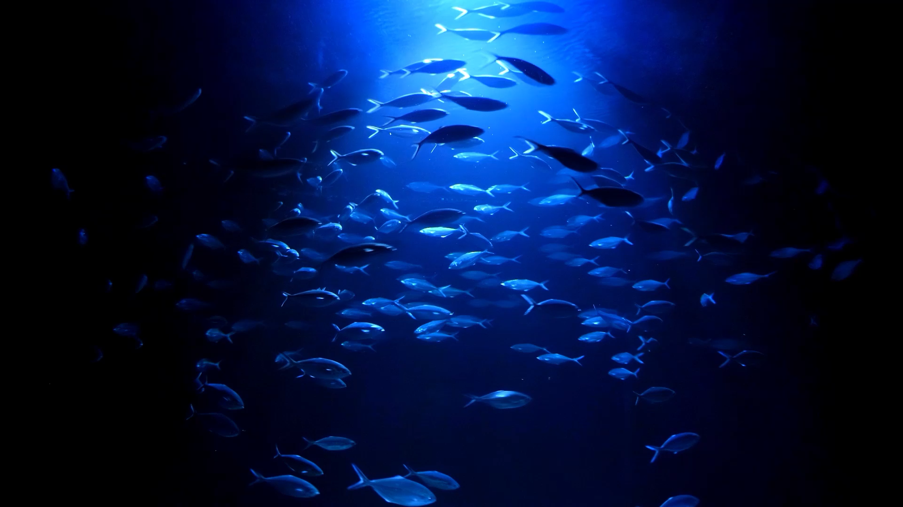
battlefish
by brianna fernandez

Slide 2
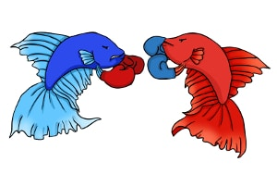
why?
Battleship is overrated and overdone
Fish are cooler than boats

Slide 3
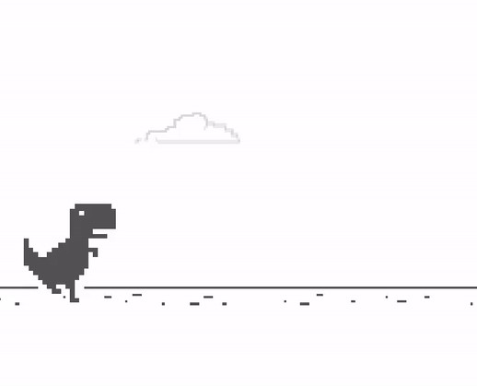
goals
Make a simple game that can be played quickly, not unlike the Google Chrome dinosaur game
Make a battleship-inspired game in which the computer plays against you
Compromise: a two-leveled game with each part demonstrating one of the goals

Slide 4
premise
You are a smuggler of illegal and exotic fish, and these chapters detail just two days of your hectic life
Chapter 1: Dispose of your fish before the authorities discover them and arrest you
Chapter 2: Kill a rival’s inventory of fish before he can kill yours and chase you out of the business

Slide 5
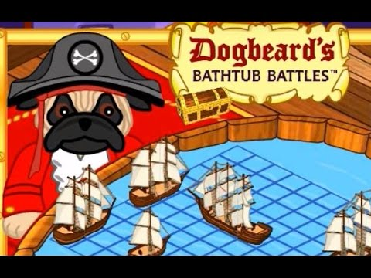
the story so far…
Welcome to BATTLEFISH!
You lead an interesting life, and the choices you’ve made have resulted in your owning a machine gun and a lot of illegal fish. Hurry! You must kill all the fish in your barrel before the FDA, EPA, and SWAT team bust you! You don’t know where they are, and you only have 40 bullets in your gun. Good luck.
Welcome to BATTLEFISH: Chapter 2
You promised yourself you’d quit, but you’ve fallen back into smuggling illegal fish. However, this time you have competition. Another smuggler is trying to shoot all your fish to get you out of the game. Quick, shoot his first, so he loses inventory and goes bankrupt!

Slide 6
demo
check me on GitHub @briannavfernandez

Slide 7
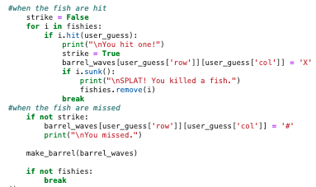
the code: chapter 1
This is part of the play() function which determines when fish are hit and when their corpses sink
Interesting features
fishies = []
barrel_waves = [["-"] * num_col for i in range(num_row)]
i.hit and i.sunk use functions from my class Fish()

Slide 8
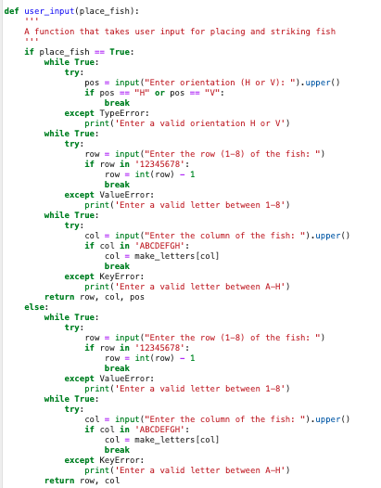
the code: chapter 2
This is the user_input() function which takes in the user’s entries for row and column and uses this to place their ships or strike the computer’s
Interesting features:
input()
make_letters()
.upper()

Slide 9

Questions?

